Slide 1
Oil Industry Investments in Alternative Energy: Comparative Rationales for Diversification and Divestment
Timothy Johnson
University of Oklahoma 2014
Notes:
Thank you to the committee for this wonderful opportunity – I do feel that I am a little bit lucky to be presenting the results of my undergraduate research project to a room full of Master’s degrees, PhDs, post-docs, and professional historians and archivists. I welcome this opportunity to share my research with a much more experienced group, and I will gladly accept your comments, questions, and criticisms at the end of this presentation. My goal with this research was to establish a more intuitive understanding for myself of what I discovered to be a very complex topic – and today I hope to inspire you and show you that this story is one that truly deserves to be explored further.

Slide 2
Research questions
What investments did oil companies make in alternative energy during the 20th century?
How did oil companies and industry observers explain their alternative energy investments and divestments?
Notes:
I’ll start with my research questions, which were really very simple.
And of course, what can we learn from this!
DEFINE alternative energy!

Slide 3
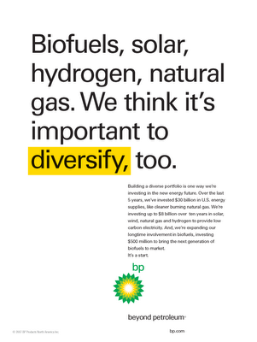
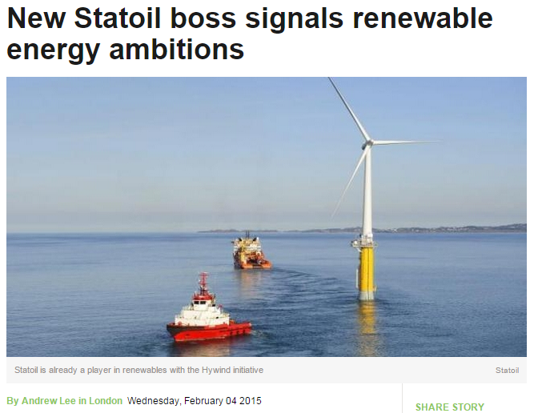
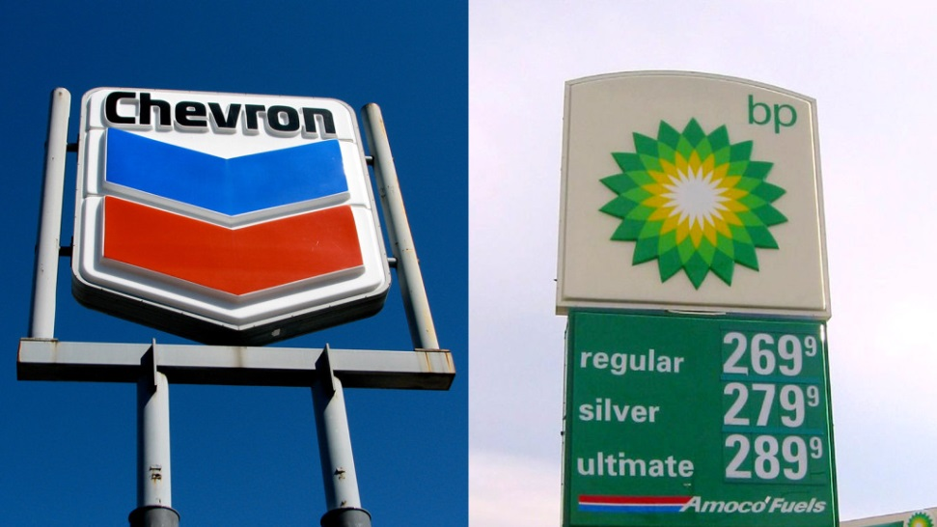
Why this topic?
If an oil company is investing in alternative energy, something genuinely interesting is happening beyond a mere “curiosity”
Historical events are relevant to current developments
“In countless advertisements, political campaigns and conferences, [oil companies] have branded solar technology as impractical and expensive, a source of power that at best will someday provide one percent of our national energy needs. [In 1980], however, solar technology appears interesting to companies like Shell Oil, Atlantic-Richfield, Northrop, Amoco, Exxon, and Mobil—all corporate giants that have taken control of solar power firms in the last several years.”
Jensen, Carl. 20 Years of Censored News. Seven Stores Press, 1997: 103.
“There was an incongruity, Shell executives realized, about oil companies campaigning to wean their customers away from oil. Commercial relationships were being undermined, and in a lopsided world, promoting heavily subsidized, uncommercial substitutes for oil could prompt a decline in consumption, and thus undermine investment to find more oil.”
Bower, Tom. Oil: Money, Politics, and Power in the 21st Century. Price, 2010: 383.
Chevron “We Agree,” 2010
BP “Beyond Petroleum,” 2002
Notes:
But of course before pursuing either of those questions, I had to answer for myself – why this topic?
SOMETHING INTERESTING IS GOING ON. You can try to compare it to, say, the traditional photography industry investing in digital photography. There’s a similar dynamic – investing in something which threatens to replace your product. But it’s not the same – oil and energy are so much more fundamental to our daily life, and are inextricably entwined in massive political, geopolitical, and social forces – such that when the price of oil goes up or down by more than a couple percentage points, it produces headlines worldwide. You can’t say that about Kodak cameras. The oil industry is also immensely profitable because it produces one of the most valuable commodities on the planet with the advantage of very inelastic demand. So, with all that in mind, when an oil company makes the decision to invest in alternative energy, it’s not just as simple as just any company making a basic choice to diversify its portfolio… because the forces involved are much larger. It demands an examination of how oil companies view themselves, an examination of the state of energy supply and demand, and of what potential they perceive for alternative energy, not to mention how they view the social and political forces that are entwined in the industry.
I think this point is well summed-up by this quote from Tom Bower’s book, Oil:
Challenges assumptions
Relevant to current events: I think each of us probably has a different timeline for when we think that oil might run out. Maybe it’s 40, 50 years from now – maybe 100, or never. But I think that most of us agree that at some point within our lifetime or our children’s lifetime, oil companies are going to have to seriously ask themselves the question of whether they can continue as a going concern without radically transforming their focus. In the first years of the 21st century, as you can see by these photos, it looked like some oil companies were beginning to tackle this question. […] But it turned out, as many are familiar, they weren’t as serious about these investments as it first appeared.
Studying the history of oil industry investments in alternative energy is important, because they might help us form conclusions about similar events which have been taking place in the 21st century. […] If we can get a better idea of why oil companies made investments in solar, geothermal, nuclear energy, in the 1970’s and 1980’s – and also why they sold off many of those investments – we will be building a stronger base of knowledge on which to analyze these more recent developments. And indeed towards the end of this presentation, I will share some conclusions on what this history can teach us about what has been happening recently, as well as under what circumstances we might expect the next wave of renewable energy investments by the oil industry.

Slide 4
timelines
a brief overview of select investments and divestments
Notes:
Just to give a brief overview of what happened, I’ve built a small timeline that shows some of the investments and divestments which took place.

Slide 5
Timeline of investments
1960’s-80’s
1960’s – early 1980’s: most large oil companies pursue alternative energy
1963, 1967: Gulf Oil acquires nuclear energy companies
1973-74: Shell commits $3MM to solar; Mobil forms solar corp
1977: Exxon involved in coal, nuclear, solar; Arco buys small solar company
1980: BP and Phillips invest in solar companies
Mid 1970’s – early 1980’s: some oil companies pursue broad, unrelated diversification
1975: Gulf pursues diversification in electronics, real estate, aerospace
1977: Exxon pursues office supplies and other diverse ventures through Exxon Enterprises
Notes:
Non-exhaustive list
Going way back, Phillips pursued nuclear starting all the way in 1950. However the majority of alternative energy investments began in the 1970’s.
A couple of examples of unrelated diversification

Slide 6
Timeline of divestments
1980’s-90’s
1981: Phillips pulls back on nuclear and coal
1981: Gulf Oil writes off nuclear investment
1982-85: Phillips sells off Acurex Solar
1989: ARCO sells ARCO Solar, which had grown to the world’s largest producer of photovoltaic cells, to Siemens
Mid-1990’s: Mobil sells off solar business
2009: Shell sells off solar division
2011: BP sells off BP Solar

Slide 7
rationales
the reasoning behind investments and divestments

Slide 8
Paranoia vs. plenty
the future of oil
Diversification: “The energy problem”
Gulf, 1975: Pursues diversification out of “desperate desire to replace its once-handsome Middle East oil profits” ¹
1979: “it has become an article of faith within the industry that the oil giants must begin investing heavily in outside businesses, preparing for that inevitable day when the oil and gas run out.” ²
Exxon, 1979: 14% shortage of oil; reserves down 20% since 1973; “obvious need” to increase revenue from nonpetroleum units ³
Divestment: The “oil glut”
1989: “Thanks to the return of cheap and easy oil and to fading memories of the gasoline lines of the 1970s, petroleum consumption suddenly is surging worldwide” ¹
Oil companies pursued “divestment and focus” strategies in response to sharply reduced revenues
Some still saw a need to diversify – but not in renewables
Exxon CEO Cliff Garvin described the oil glut as “temporary” and continued his company’s search for a “bridge” between fossil fuels and renewable fuels -- shale oil ²
1: Tanner, James. "Petroleum to Keep Rank as Most Valuable Commodity." The Wall Street Journal, Mar 6, 1989: A5.
2: Tracy, Eleanor Johnson. "Exxon Gets Serious About Shale." Fortune, May 18, 1981: 62-64.
Notes:
DIVERSIFICATION:
two oil crises in the 1970’s bring soaring oil prices, concerns about dependence on foreign oil, and paranoia about supplies; oil companies pursue alternative energy as a hedge against an uncertain oil future
DIVESTMENT:
The “oil glut”; predictions in 1980 of $250/bbl oil give way to a surge in supplies and collapse in prices
Oil remained the dominant source of revenue for the oil majors

Slide 9
Core competencies
expertise and synergy
Divestment:
Broad, unrelated diversification projects were the first to go:
Gulf, 1977: “No longer will Gulf toy with making acquisitions outside the energy field […] We have decided to stick with the things we know best [oil, coal, and uranium].” ¹
1981: Failures at Exxon Enterprises blamed on “oilmen with little knowledge of manufacturing” ²
Arco, 1989: sold off solar to “concentrate on its core oil, gas, coal, and chemicals business” ³
In 1998, re-defined “core” again and described coal as “noncore” ⁴
1990’s: reduced revenue from “core” operating segments pushes Shell, Arco and others out of coal
Diversification:
1968: oil industry’s move into coal described as “natural” due to massive mineral leaseholds and skilled geologists ¹
1973: “uranium separation is essentially a chemical processing problem, and Exxon ‘has broad experience in building and operating complex processing plants.’” ²
Shell, 1977: “The firms that make up the United States energy industry have the expertise and the experience, as well as the willingness to take financial risks, that will be needed to provide the best possible mix of energy sources at the lowest possible cost.” ³
Exxon, 1977: diversifies “with complementarity in mind” ⁴
“Exxon’s coal companies, benefiting from the resources of their parent, quickly became industry leaders in productivity, personnel management, and safety. They were also showing a modest profit by 1980.”
1: "Gulf Oil goes back to what it knows best." Business Week, January 31, 1977: 78-80.
2: Beman, Lewis. 1981. "Exxon's $600-Million Mistake." Fortune, October 19: 68-87.
3: Rosewicz, Barbara. 1989. "Arco Is Trying to Sell Solar-Panel Unit, Reversing Move Into Alternative Energy.”
4: Ewing, Terzah. "Atlantic Richfield Is in Talks to Sell U.S. Coal Business to Beacon Group.”
1: Tanner, James C. 1968. "U.S. Oil Firms Scramble for Other Minerals As Proven Reserves Slump, Expenses Soar."
2: Business Week. 1973. "GE and Exxon join to make nuclear fuel." Business Week, June 30: 28.
3: Shell Oil Company. Shell Oil Company Annual Report -- 1979. Ann Arbor: ProQuest Annual Reports, 1979.
4: Uttal, Bro. "Exxon has its eye on more than just oil." Fortune, April 1977: 166-168.
Notes:
Oil companies tested the limits of their managerial & technical skills in projects ranging from alternative energy to office equipment
Divestment:
As circumstances changed and projects failed, oil companies began to re-define their “core”

Slide 10
Prospects for alternatives
market potential
Diversification
1970’s: “bullish” profitability projections for coal influenced oil company mining investments ¹
Shell, 1975: increased investment in solar due to “increasing prospects for the widespread use of solar photovoltaic devices” ²
Exxon, 1977: solar investments targeted for “high growth potential” beginning to show “favorable economics” ³
Diversification projects aimed to grow earnings by 5-10% by the 1990’s
Phillips, 1979: “[oil, natural gas, coal, and nuclear power] must provide the bridge between now and the 1990s when newer forms of energy are developed and commercialized in significant quantities” ⁴
Divestment
Exxon described past alternative energy investments as “not as reliable or affordable as conventional fossil fuels;” described market barriers due to “technological limits and excess costs.”
Arco, 1989: the solar unit was “never profitable” ²
1: Davis, Jerome. 2006. "Why Don't Oil Companies Commit to "Renewables"?" In The Changing World of Oil, by Jerome Davis, 169-189. Burlington, VT: Ashgate Publishing Company: 185.
2: Rosewicz, Barbara, and Frederick Rose. 1989. "Arco Is Trying to Sell Solar-Panel Unit, Reversing Move Into Alternative Energy." The Wall Street Journal, February 27: B3.
1: Hirsch, James S. 1992. "Shell Oil Co. Plans to Leave Coal Business." The Wall Street Journal, June 22: A4.
2: Shell Oil Company Annual Report – 1975
3: Exxon Corp. Annual Report – 1977
4: Phillips Petroleum Company annual report, 1979

Slide 11
The “whiplash effect”
politics and government
Divestment
Shell, 1979: “To encourage the [oil] industry to make [energy] investments, the government needs to establish policies that are consistent with clearly defined, long-range national goals” ¹
1977: President Carter imposes ban on nuclear reprocessing
1981: President Reagan cuts off energy R&D and “by all accounts […] had a ‘profound and mostly negative’ impact” on alternative energy investments, particularly on solar ²
Divestiture legislation characterized as “the greatest threat to [the oil industry] since the breakup of the Standard Oil Trust” ³
1982: “Now that world oil prices have tumbled and fears of an embargo receded, federal officials threaten to suspend their crucial financial support [for alternative energy]” ⁴
Diversification:
Government as a force for alternative energy:
1950-1969: Phillips Petroleum atomic energy research takes place under the US government’s Atomic Energy Commission
“Almost 25% of all the money the [US] gov’t spent on energy research between 1961 and 2008 was doled out between 1974 and 1980.” ¹
US gov’t funding peaked at $7.5bn in 1980
Provided a “framework” for investing in alternative energy sources
Government as an obstacle to oil and gas:
1976: “The problem is that the government only gives the oil companies enough financial incentive to invest a part of their available cash in oil and gas production.” ²
1977: “Exxon’s goal is to develop options for the future, mainly in case the political storm clouds over the oil industry finally burst.” ³
1: Madrigal, Alexis. Powering The Dream: The History and Promise of Green Technology. 2011: 138.
2: Carberry, James, and Nancy Cardwell. 1976. "Oil Companies Are Seeking to Diversify As Politics, Economics Impose Restraints." The Wall Street Journal, June 23: 38.
3: Uttal, Bro. 1977. "Exxon has its eye on more than just oil." Fortune, April: 166-168.
1: Shell Oil Company Annual Report – 1979
2: Exxon Corp Annual Report – 1977
3: Madrigal, Alexis. Powering The Dream: The History and Promise of Green Technology. 2011: 139.
4: Marbach, William D. "Synfuels in Jeopardy." Newsweek, April 19, 1982: 74.
Notes:
Oil companies decried inconsistent government policy and divestiture legislation

Slide 12
Windfalls and shortfalls
capital budgeting
Divestment
Exxon, 1974: “We need to finance our business. We’re a corporation.” Not willing to accept “marginal” investments, regardless of the financial circumstances. ¹
1979: Despite capital surplus, Shell “ties its future almost entirely to oil”; pursues M&A when drilling plays run out ²
1980’s: Takeover attempts on Phillips Petroleum Company result in “greenmail” response and budget cutbacks
1982: “We’re cleaning up the shop. We can’t afford little operations that can’t hold their own weight.” ³
Diversification
Shell, 1973: joined a solar energy enterprise “in response to the changing petroleum supply situation” ¹
Gulf, 1975: “Now that [foreign oil] is shut off to us and now that domestic oil demand is no longer growing as fast, we have more capital available for diversification.” ²
Exxon, 1977: “In the future, returns in the oil industry may be lower, and there may not be many options for an oil company. And it looks more that way now than when we started this effort.” ³
1979: “Because of worldwide oil price increases, [Exxon] continues to have an embarrassment of riches. The situation cries out for a strategy of massive diversification to pump large amounts of the company’s bountiful cash into businesses with a brighter future than oil.” ⁴
1: New York Times. "Mr. Exxon on the energy future." April 21, 1974.
2: 1979. "Shell Oil: Bucking an industry trend by driving deeper into oil." Business Week, December 3: 92-96.
3: Shao, Mario. 1982. "Oil Firms' Capital, Exploration Outlays Are Expected to Be Flat or Decline in 1983." The Wall Street Journal, December 27: 20.
1: Uttal, Bro. "Exxon has its eye on more than just oil." Fortune, April 1977: 166-168.
2: Business Week. 1975. "Gulf's stunning break with oil tradition." Business Week, June 30: 29-30.
3: (Uttal 1977)
4: "Exxon: Searching for another game that equals oil in size." Business Week, July 16, 1979: 80-81.
Notes:
Diversification stems from excess capital (surging oil prices), combined with lack of incentives for E&P (rising costs + political difficulties)
1981: Exxon Enterprises “losing money at a rate that could bankrupt almost any other office systems manufacturer”

Slide 13
conclusions
what can we learn from this?

Slide 14
Conclusions
This research shows the influence of many different factors on alternative energy investment by oil companies:
Prospects for oil and gas
Prospects for renewable energy
Capital resources and profits
Political and regulatory constraints and incentive structures
This research also indicates that each factor, on its own, is not always a consistent predictor of investment or divestment in alternative energy
Notes:
If you’re looking for a one-size fits all answer, you certainly won’t find it. That’s the nature of historical research.
However, what we can gain from this is a framework of factors to consider, based on what we have learned about the importance of these factors over time and in different circumstances.
Are oil companies concerned about whether or not they can make any money off of alternative energy? Certainly – but if they’re more concerned about whether or not they can continue making money off of oil, then their decision-making might change. Think about the 1970’s when the industry faced geopolitical constraints, legislative threats.
Do oil companies think that alternative energy has a strong market future? In the early stages of development in the 1970’s, Exxon Solar thought that solar would become a $50 billion industry within 20 years after achieving cost parity with oil, coal, and nuclear fuel.

Slide 15
Then versus now
1970’s-80’s
Declining reserves
Geopolitical barriers
Oil prices rise, then crash
Political threats to oil
Divestiture legislation in the US
Heavy regulation of US oil industry
Incentives for alternative energy
US energy policy + research
Energy independence
Capital surpluses, then shortfalls
Windfall profits from high prices
Budget cuts following the crash
2000’s-10’s
Declining conventional reserves
Oil prices rise, then crash
Political threats to oil
GHG regulation
Fracking regulation
Divestment campaigns
Incentives for alternative energy
Tax subsidies
Environmental responsibility
Reputation management
Tight capital budgets
Profits from high prices
“Capex treadmill” of tight oil

Slide 16
Conclusions
the present and future
One significant difference between past and present is the heightened focus on expensive unconventional reserves
In the late 2000’s, oil companies abandoned renewables when capital-intensive unconventional reserves, which had not been explored since the 1970’s, demanded all of their attention and resources
Whether or not oil companies will eventually re-invest in alternative energy will likely depend on a combination of incentive structures for oil and gas versus alternative energy investments
Despite the recent price crash, sharp cost controls could result in a return to capital surpluses – similar to what happened in the 1980’s
Combined with declining conventional reserves, higher-cost unconventional production, and the threat of significant climate regulation, alternative energy might begin looking attractive to oil majors again from a fundamental perspective

Slide 17
Next steps
Accept any comments, criticisms, and suggestions
Incorporate more financial data
“Performance Profiles of Major Energy Producers” (US EIA)
Incorporate archival work
Dig deeper into the late 80’s – 90’s
Why did many solar investments survive the “divest and focus” campaigns?
Explore primary sources
Retired researchers and executives

Slide 18
Thank you!
Timothy Johnson
johnson.TCP@gmail.com
Tweet @Energy_Nexus

Slide 19
Conclusions
comparative rationales
Alternative energy markets & growth potential
Oil companies were some of the first pioneers of solar energy, before any serious commercial markets had been proven
Strong markets have also served as a reason for recent divestments – “too much competition!”
High oil prices / profits / capital surpluses
Initial investments into coal and nuclear began before the oil shock of 1973
Divestments in the 2000’s occurred in the midst of high oil prices
Notes:
AE markets – today, you might

Slide 20
Conclusions
comparative rationales
Government / social pressures
In the midst of alternative energy investments, oil companies were opposed by both the government and society at large
Oil companies exited renewables in the 2000’s despite a growing environmental movement
Gov’t support has served as both an enabler of diversification (e.g. Phillips nuclear) and a deterrent (oil companies today don’t want to “rely on subsidies”)
Core competencies:
Oil companies at first described alternative energy investments as “complementary”, then as “non-core”
Notes:
In the 70’s and early 80’s, it’s not as though oil companies were capitulating to society’s demands… on the contrary, most people blamed oil companies for the ongoing energy crisis, shortages, and accused them of forming a conspiracy to restrict alternative energy.

Slide 21
Contemporary investments
Diversification:
1997: BP’s John Browne pledges action on climate, investments in renewable energy
2004: ChevronTexaco decides to become a “quiet industry leader on climate change”
Divestment
2011: BP Solar “found it difficult to compete against newer rivals” and struggled with oversupply and profitability
From “industrial bankers” to the “lean corporation”
R&D budget cuts; alternative energy first to go
Shell, 2007: “Posturing for publicity purposes was harmless, but relying on the profitability of renewables was foolish.”
“Tough times” for oil leads to re-focus on “core”
“Extraordinarily risky and expensive” techniques
“Less welcome at the foreign oil fields” due to tougher deals
Despite higher profits, oil now takes “all of your resources to remain profitable”

Slide 22
Timeline of divestments
2000’s
2007: Shell divests CCS, solar, and wind
2009: BP alt-energy chief retires; company cuts renewables budget by $400-900M
2009: Shell “abandons all new investment in wind and solar”; BP abandons CCS and closes renewables headquarters (County Hall); both pursue tar sands
2011: BP exits solar after 40 years in the business
2013: BP divests wind power assets

Slide 23
Existing scholarship
https://halshs.archives-ouvertes.fr/hal-00763647/document
Focuses on core competency
Misses out entirely on history pre-1980
Concludes that further investment/divestment will depend on profits
http://www.researchgate.net/publication/227422009_Strategy_structure_and_market_turbulence_The_international_oil_majors_1970-1991
“From stability to turbulence”
Flexibility vs integration
Other research is primarily focused on the late 90’s-2000’s
Notes:
And finally, I’d like to establish my research within the existing body of scholarship.

